Slide 1
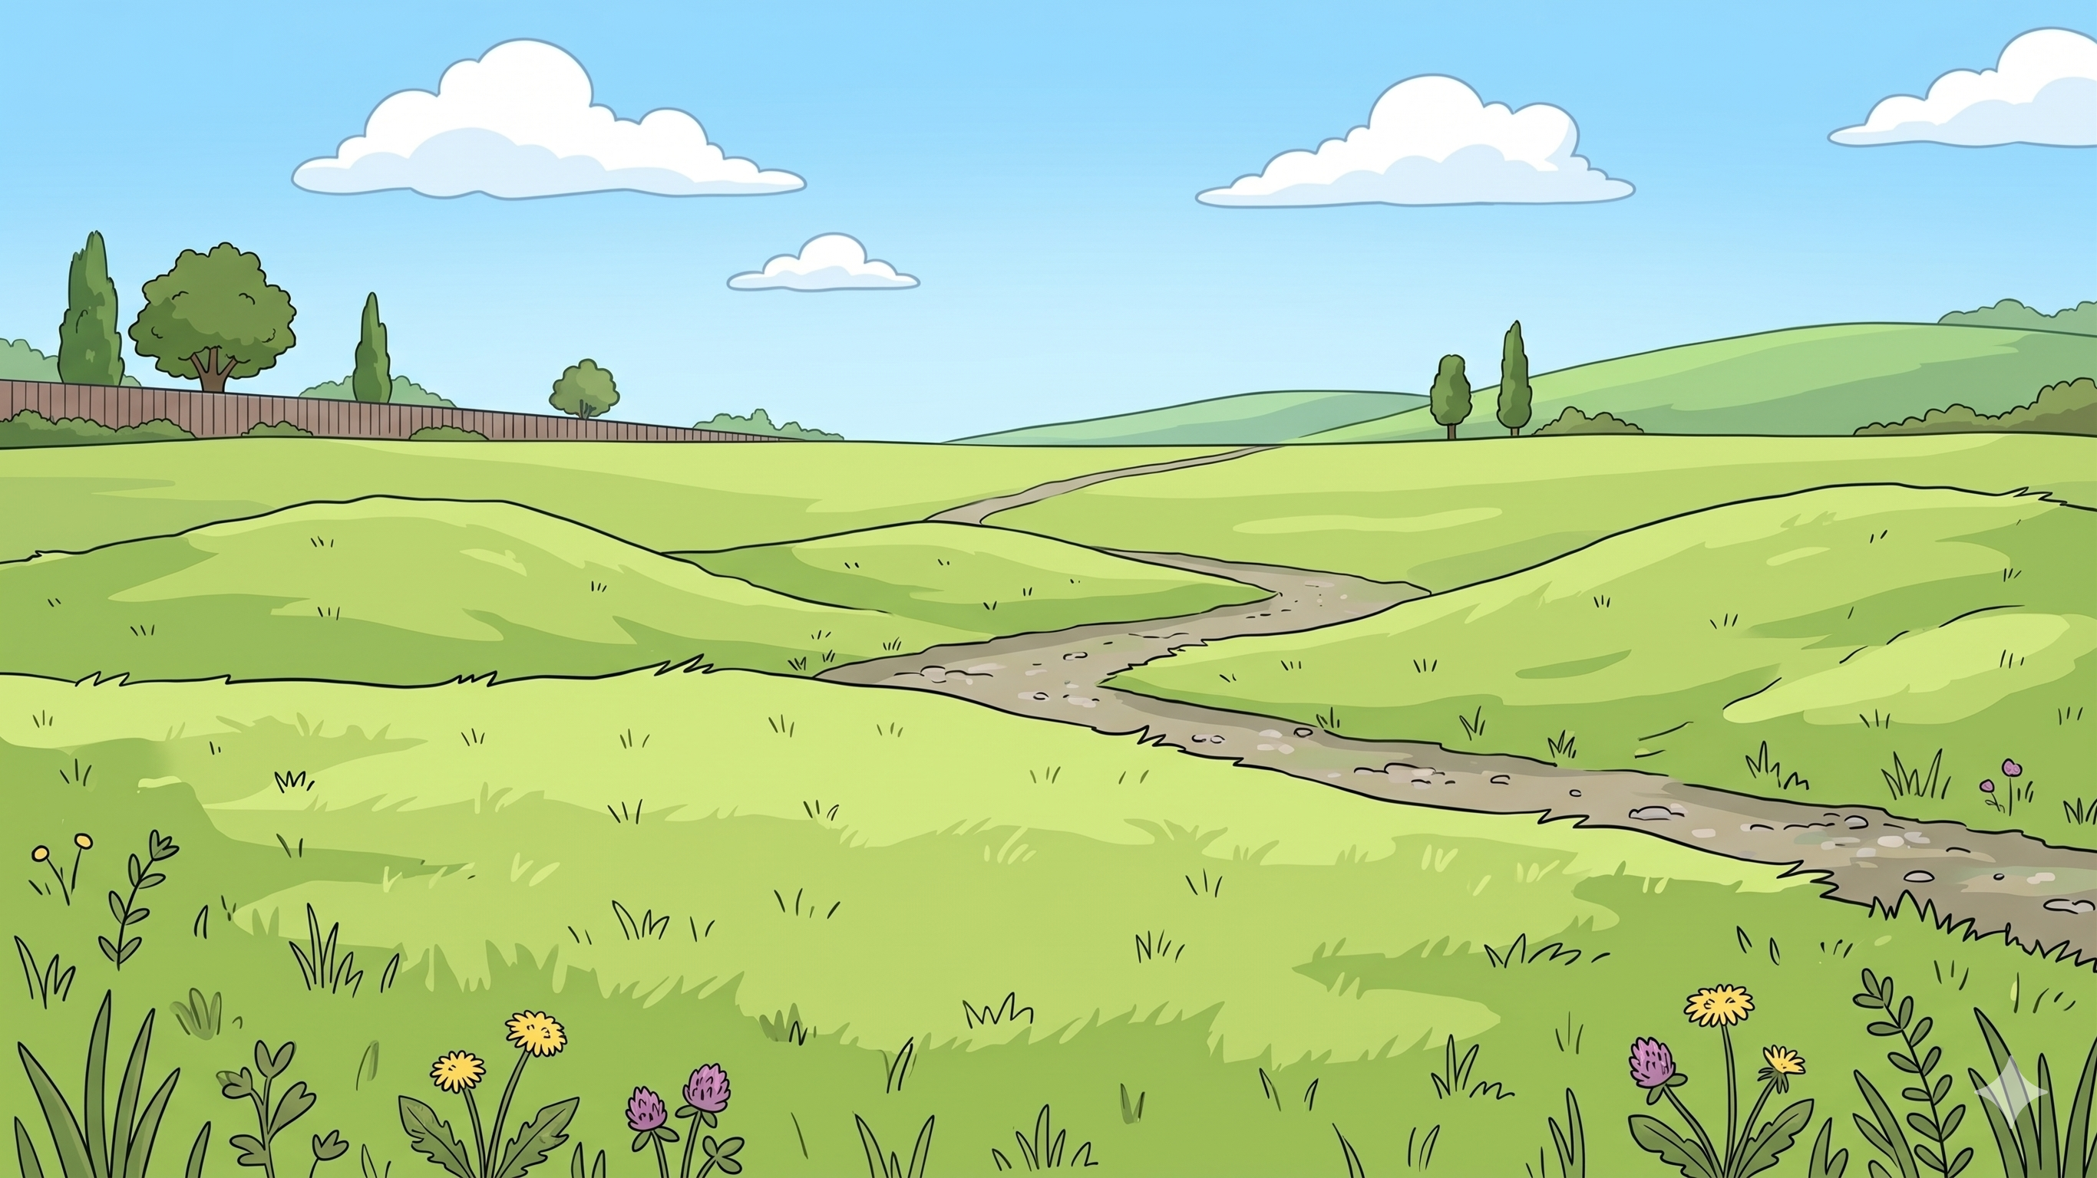
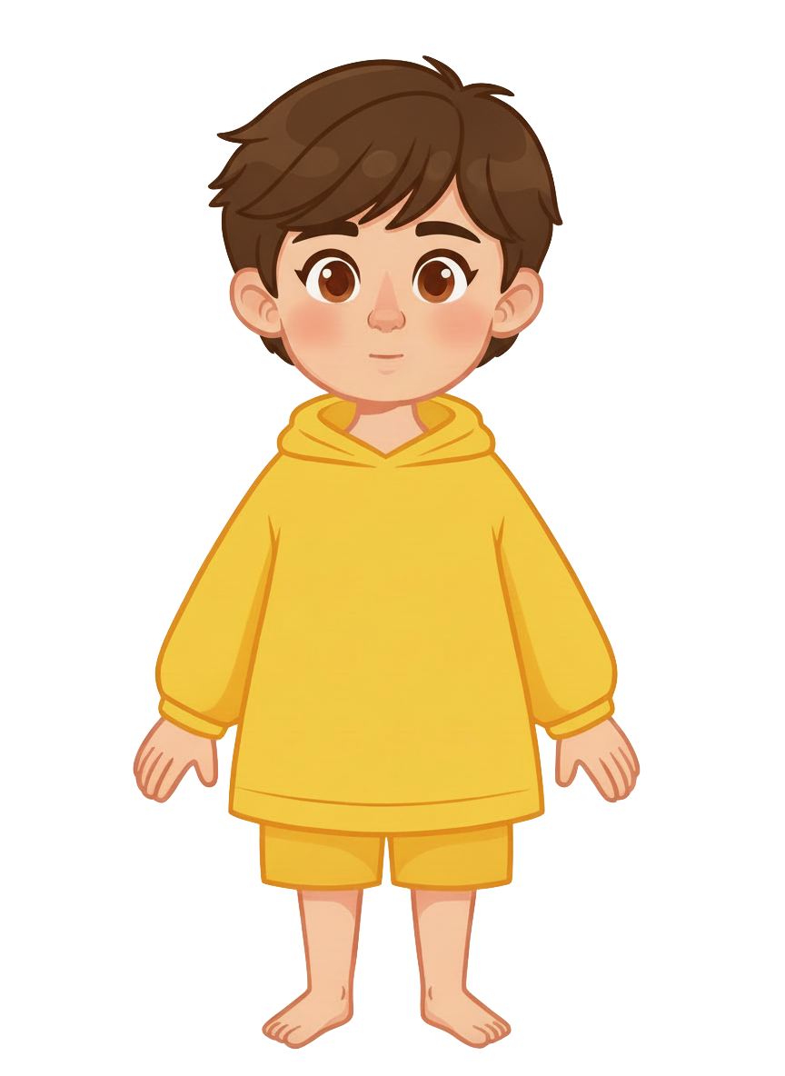
This is Sam

Slide 2


Sam has 5 cookies

Slide 3
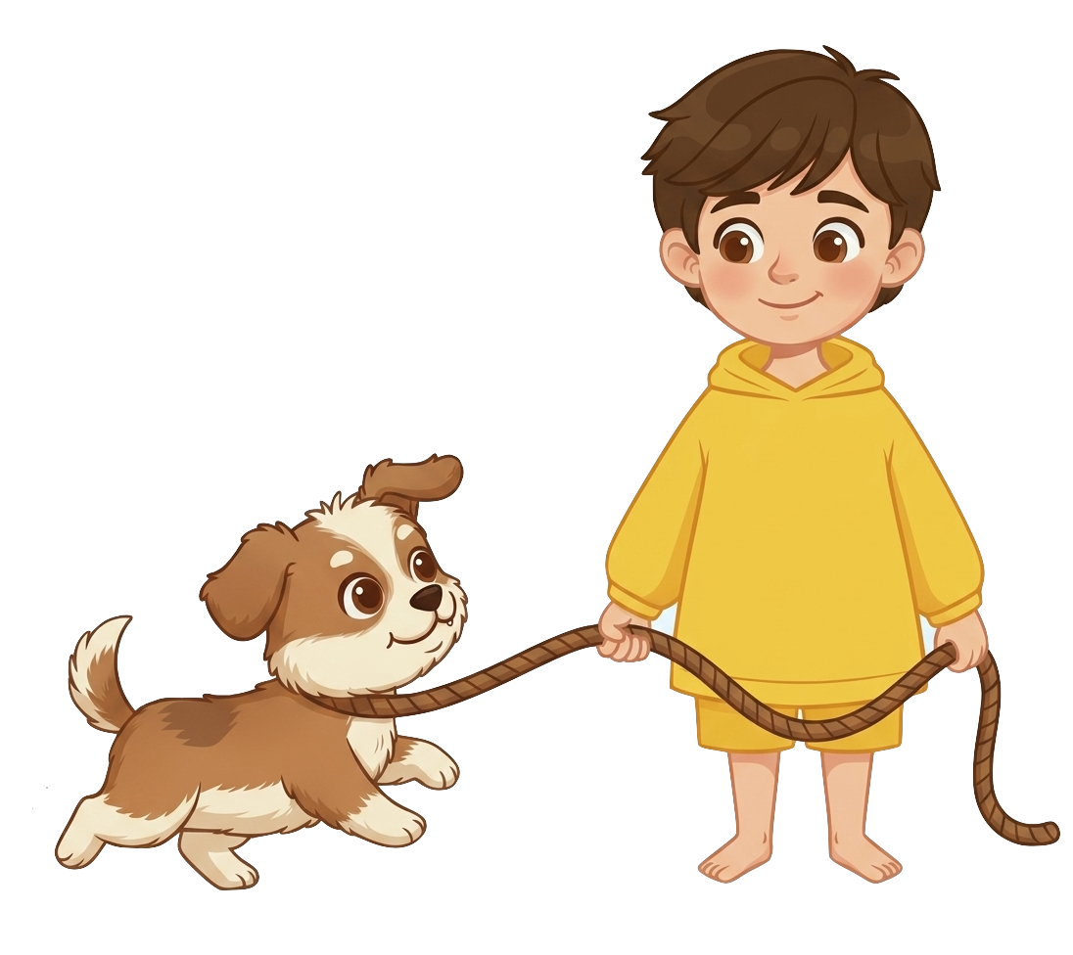
Sam has a dog

Slide 4
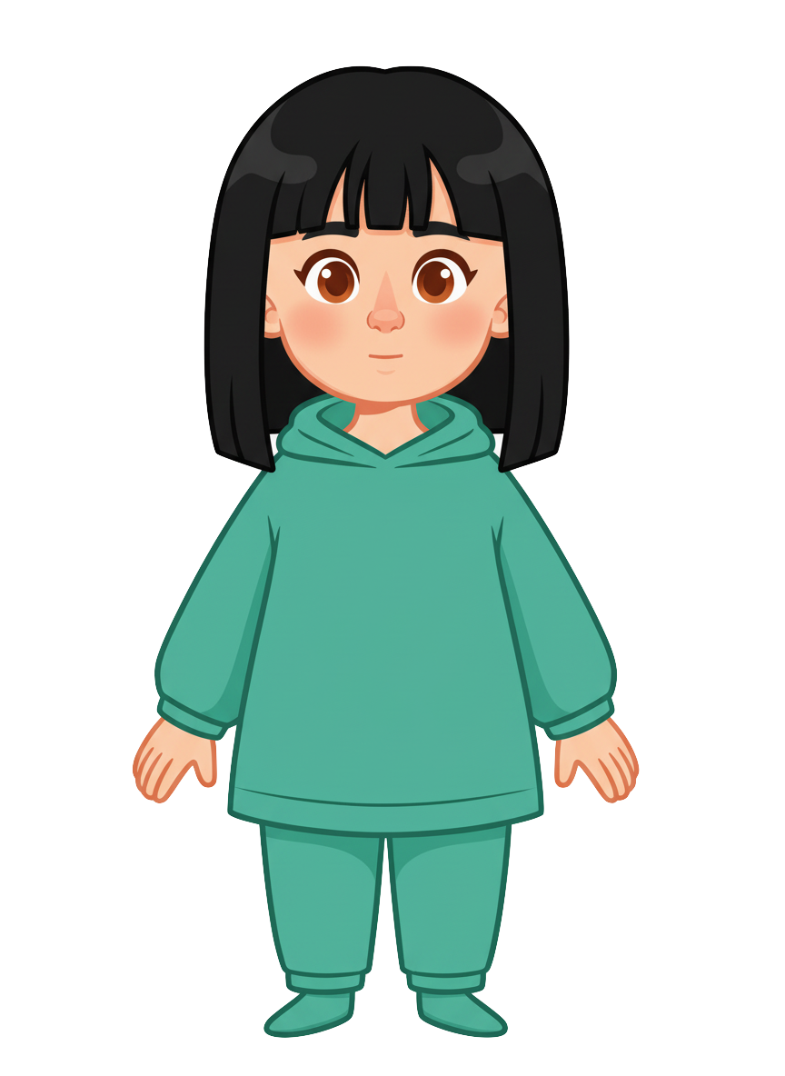
This is Ella

Slide 5
Ella has 3 cookies

Slide 6

Sam is walking his dog

Slide 7
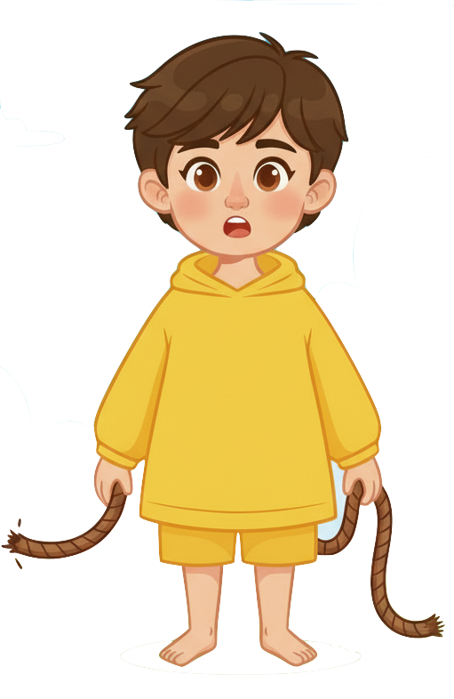
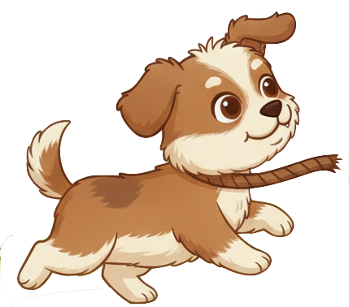
Ohno! The dog broke free from the leash

Slide 8
Ohno! The dog broke free from the leash

Slide 9
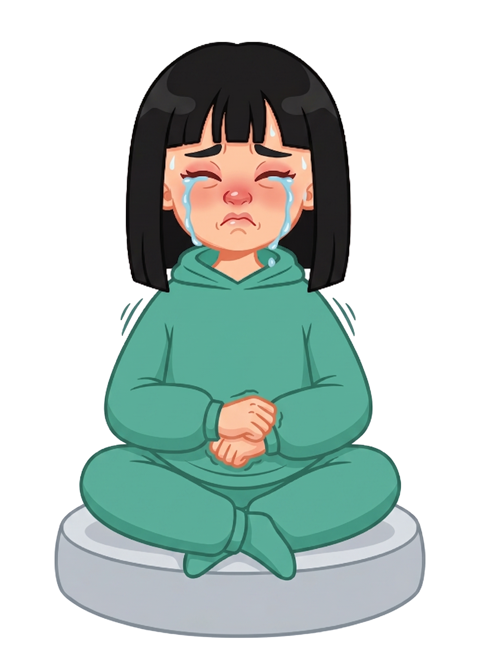

The dog ate 2 of Ella’s cookies!

Slide 10
Sam still has 5 cookies. Ella now has 1 cookie.

Slide 11
Please decide whether you would like to move some of Sam’s cookies.

